Slide 1


AI SAFE TRAVELS
At Safe Travels, our mission is simple: to keep travelers sound & safe and connected unlocking the power of AI.
“11.7 M visitors in Barcelona”, INE
March 2025
Group 18 – Dani González, Joan Ignasi Guardia, Víctor Fosch, Miguel Robledo, Aleix Sicilia

Slide 2

Our mission At Safe Travels, our mission is simple: to keep travelers safe and connected unlocking the power of AI. We use advanced technology to provide real-time security updates and ensure strong, reliable network connections. We prioritize your privacy and aim to make your travel experience secure and enjoyable. They can also warn other users about potential threats and connect with local authorities so they can act with real-time data.

Slide 3





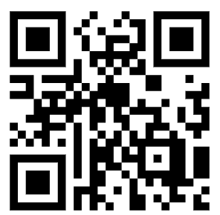
Our idea
Emma wants to visit European cities
She is not familiar with the new city and checks our app
Warn other users & feeds the system
Direct contact with local authorities
Tips about local culture & regulation
AI Safe Travels
PRIVACY: Only sharing data if user is registered, we gather their phone location, density and check her location on-time (European Data Regulations)
Provides Machine Learning AI Recommendation to Emma about safety according to her situation
E.g., it compares different neighborhood, level of density, historical level events, animals, traffic, seasonality, other users on-time awarenesses
LOGIN DETAILS
doctor@test.com
test1234
Our solution
AI SAFE TRIPS

Slide 4





Data TO FEED THE MODEL
[1] Inactive in Spain
[2] To be scaled up
Required
Device status
AI-Machine Learning recommendation about level of safety for tourist
Authorization from user to use data
External data from the city (whether, fire, emergencies, natural disaster,
Data from device (level of noise, density, under premises, driving…)
Personal information from user (use of pets, ethnicity, vulnerable group
Location (if user is in certain locations)
User can also warn other users
Historical data (Source: BCN police – Guardia Urbana)
Emma will feel more confident and secure
Receive
Recommendations
With real-time data (if there is danger or not)
Contact authorities or our services by collaborating with local 112
Location retrieval [1]
Location authorization
Warns data to other users
Phone verif.
User verif. [2]
Density pop.
Real-Time Security Alerts: Instant notifications about potential threats based on location.
Dynamic Quality of Service (QoS): Seamless connectivity with automatic network quality adjustments.
Location Tracking: Monitors tourist locations for relevant safety information.
Specialized Network Slices: Tailored network slices for optimal performance and security.
Privacy Protection: Secure consent and identity management protocols.
Congestion Management: Proactive management of network congestion for consistent service quality.

Slide 5





Our added value
AI RECOMMENDATION FOR TOURISTS IN REAL-TIME
SIMPLIFY COMMUNICATION IN CASE OF ACCIDENT
CONFIDENCE
STRICT PRIVACY BETWEEN AUTHORITIES
Authorities receive data about incidents, generate tailored action plans and can mitigate risks
DATA DEMOCRACY
LOCAL TOWNS RECEIVE ADVANCED ANALYTICS TOOLS, DATA AND REAL-TIME INSIGHTS TO IMPROVE

Slide 6
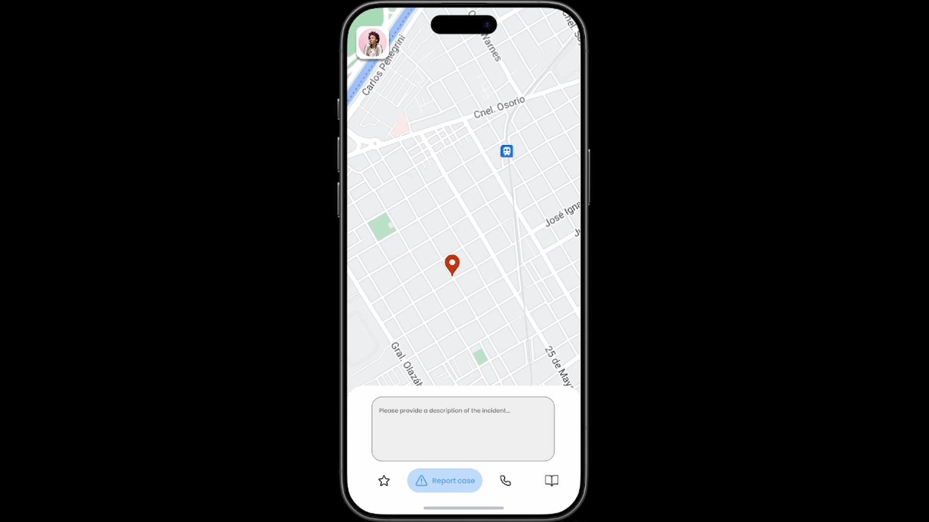
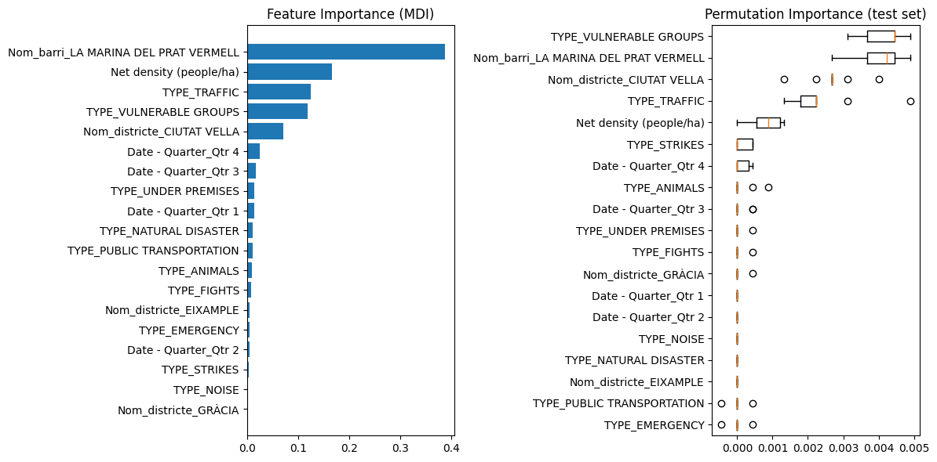
With the previous data we can warn user about level of incident and they can warn others using NOKIA API inputs with >98.1% accuracy (Model: Gradient Boosting)
What impacts the risk of event
Model → ML-SafeTrips.ipynb - Colab

Slide 7
ANALYSIS for local authorities in real-time and real data

Slide 8
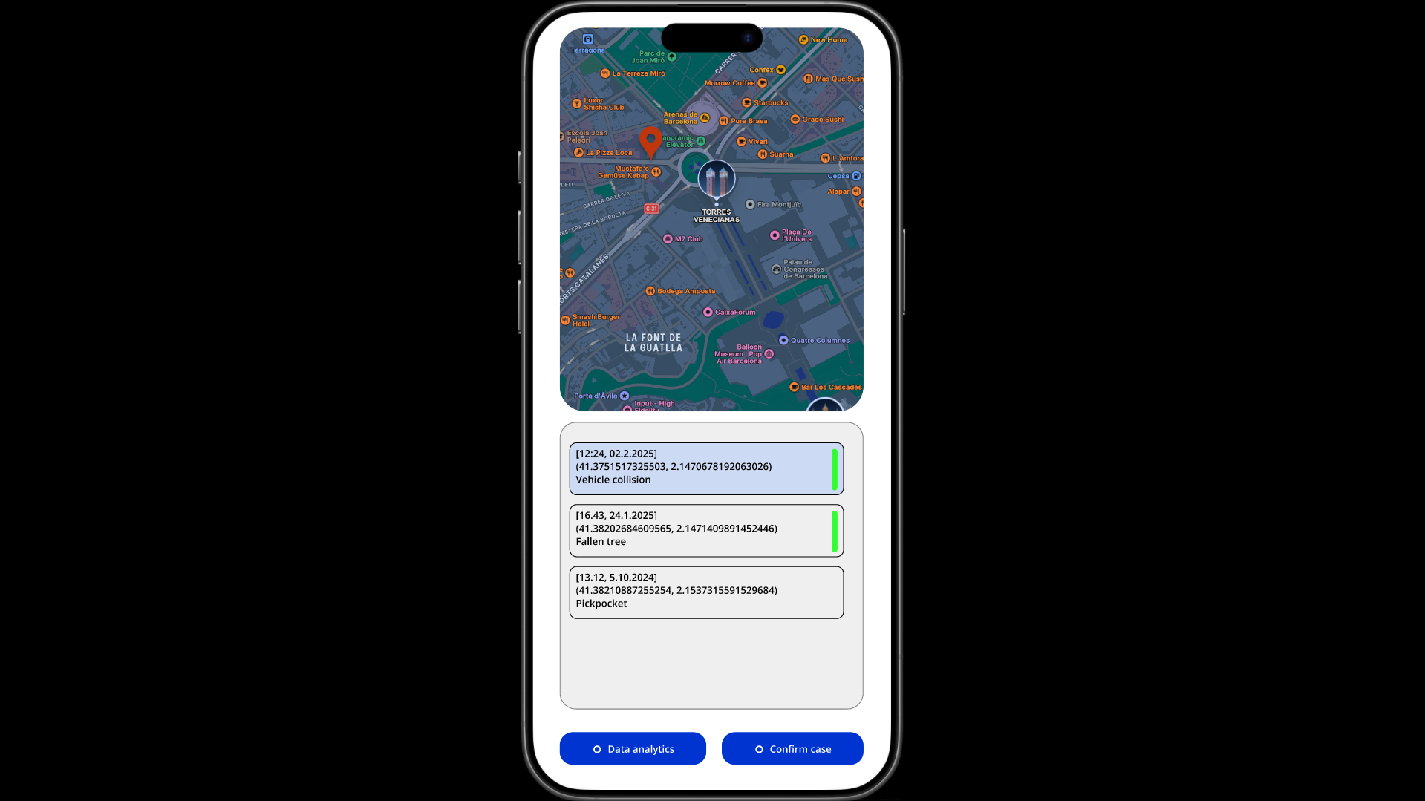

AUTHORITIES ANALYTICS

Slide 9
Business impact
Income
Contract with local authorities (4.45 M€/y)
Travel Insurance commissions (2 M€/y)
Total Ind. Costs = 4.45 M€/y & city
Costs
External Provider (1.2M€)
11 salaries (0.7M€)
Marketing (1M€)
10% Contingency (0.29M€)
Total Ind. Costs = 3.3 M€/y & city
Other fixed costs: 1.6 M€/y
R&D in Data Science: 0.5 M/y
Social impact + Expected profit (10 cities) 9.4M€
ROI 28%

Slide 10




SCALABILITY
KEY partners
2025+: Next steps
Integration & collaboration with each local system
Regulatory affairs due to european data privacy laws
Increased security & data storage capacity
Standardize emergency systems communications in non-developed cities
Discounts and collabs with districts
Others
Local Institutions, insurance companies and EU commission
SERVICE PROVIDERS: Nokia, PowerBI and SQL databases
VERIFICATION SERVICES (E.G., 112 IN SPAIN OR 911 IN THE US)
Long-term goals: Purpose-driven company
Expand our services to more cities while we support our communities with data transparency
Scale to new scopes about security

Slide 11
Let’s travel SOUND & SAFE with your ai LOCAL buddy
AI SAFE TRAVELS

Slide 12
AI SAFE TRAVELS
Would you use our platform in case of visiting NY, Lagos, Cairo or Tokyo?
MOBILE WORLD CONGRESS
MARCH 2025

